Slide 1

Wise Wednesday Part 2: Overview of Coaching
Richard Strilowich,
GTS Manager, Enterprise Automation Distributed Services
Leadership Council member, IBM Coaching Community of Practice (CCoP)
February 2021

Slide 2
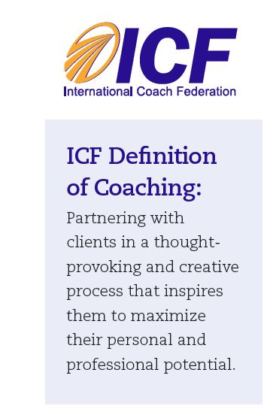
What and Why of Coaching
Standing on this foundation, the coach's responsibility is to:
Discover, clarify, and align with what the client wants to achieve
Encourage client self-discovery
Elicit client-generated solutions and strategies
Hold the client responsible and accountable
This process helps clients dramatically improve their outlook on work and life, while improving their leadership skills and unlocking their potential.

Slide 3
Coaching vs. Mentoring
Coaching
Mentoring
Asking powerful questions to challenge and expand thought processes
Transferring skills and expertise
Holding you accountable for outcomes
Connecting you with resources
Helping you through transitions
Expanding your perceptions on what you can do
Acting as a sounding board
Focusing on you setting and reaching your own career objectives
Supporting you as you work to achieve your goals
Giving you career advice
Coach
Someone who partners with IBMers in a thought-provoking and creative process that inspires them to maximize their personal and professional potential
Mentor
Someone who transfers his/her own experiences, knowledge, and advice to others while ‘giving back to IBM

Slide 4
Focus of Coaching
4

Slide 5
How of Coaching
GROW model of coaching
Go forwards and backwards around the model as necessary.
WILL
Commitment to Action
What will you do?
When will you do it?
What help do you need?
GOAL
What do you want?
Specifically what do we want to
achieve in this session?
What's the long-term
objective in mind?
Asking rather than telling
Listening rather than speaking
Empowering rather than directing
OPTIONS
What could you do?
What options are available?
What new possibilities are there?
REALITY
Where are you now?
What's happening now?
What have you done so far?
Who / What is involved?
5
Adapted from "Coaching for Performance" Sir John Whitmore.
Notes:
The summary of the GROW model.
Additional highlights are that GR is more about raising awareness / diagnosis, (something that leaders don't do often), whereas the OW are more about generating responsibility / implementation, (leaders often jump in here!)
Give them a copy of this + the 1 page coach for their practice sessions.
Goals should be SMART
We can go back and forth round the model: GRGRGRGROW
Awareness is mainly raised in G & R
Responsibility is mainly generated in O & W

Slide 6
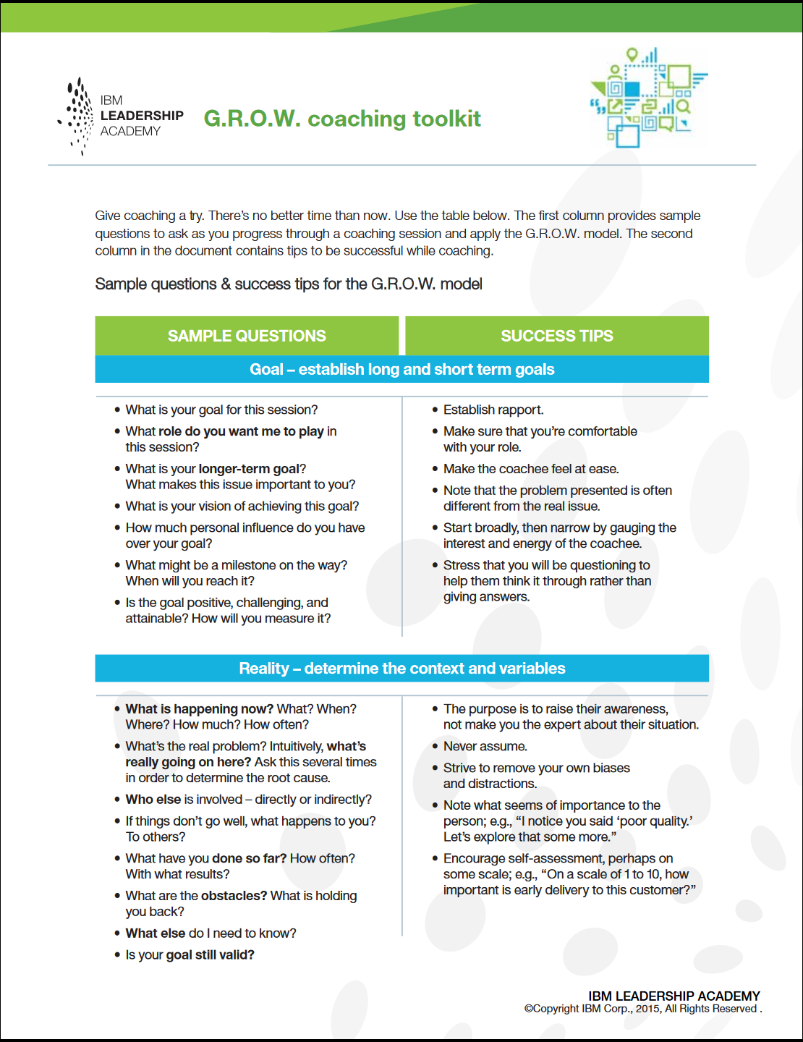
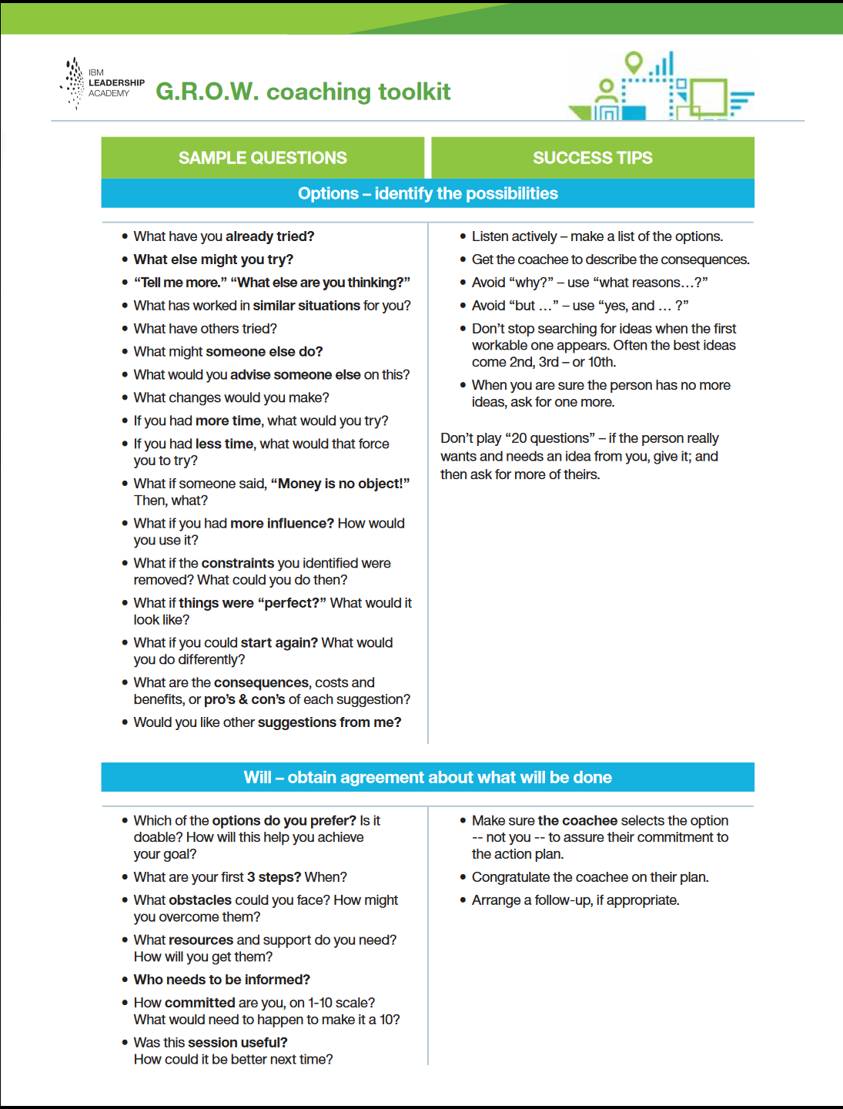
GROW Coaching Toolkit
6
Notes:
The summary of the GROW model.
Additional highlights are that GR is more about raising awareness / diagnosis, (something that leaders don't do often), whereas the OW are more about generating responsibility / implementation, (leaders often jump in here!)
Give them a copy of this + the 1 page coach for their practice sessions.
Goals should be SMART
We can go back and forth round the model: GRGRGRGROW
Awareness is mainly raised in G & R
Responsibility is mainly generated in O & W

Slide 7
Coaching Demo

Slide 8
Backup Slides

Slide 9
Coaching in IBM – Coaching Community of Practice
IBM Coaching Community of Practice (CCoP) – Join at https://w3.ibm.com/w3publisher/ccop-coaching-news
Membership over 5000 IBMers globally spanning every business unit
Celebrating our 21st year!
The IBM Coaching Community of Practice (CCoP) is a social group of passionate IBM'ers who are learning, practicing and amplifying professional coaching throughout the IBM enterprise.
We do this through:
Providing a community for IBMers to collaborate and connect around Corporate Coaching interests
Creating a global IBM Coaching movement that influences the coaching and hacking culture, to enable exceptional business results.
Developing offerings and opportunities for IBMers to learn business coaching skills
Growing and practicing 1-1 coaching skills through Partnering with IBM organizations (recovery based)
The CCoP is:
A volunteer COMMUNITY focused around Corporate Coaching competency
It embraces IBMs diverse and inclusive culture
It spans all global IBM business units
Operates as a grass roots, sponsor-free community (not aligned to an IBM organization)
9

Slide 10
Coaching Feedback
Coaching Session
Client’s Feedback
Coach’s Feedback
Observer’s Feedback
Coachee: Tell me, how was that for you?
Coach: What did you learn about your own coaching during the coaching conversation?
“The shortest feedback loop I can think of is doing improvisation in front of an audience.”
– Demetri Martin
10

